Slide 1
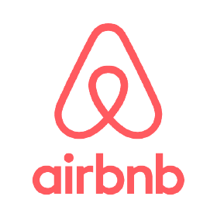
Thomas Han

Slide 2

Questions
Which neighborhood should our investor choose to invest in for an Airbnb rental in Washington, D.C.?
How much revenue do successful hosts generate?
Which property types receive the most positive reviews?
Which neighborhoods host the most listings?
Which neighborhoods receive the most positive reviews?

Slide 3
Process
Clean the data
Checked if there was any duplicate listings in column “ID”
None found
Removed listings that had no records of posting a review
Find & Replace to standardize entries for city and states
Used “neighborhood_cleansed” column
Calculated “Number of Stays” by multiplying 2 from “Number of Reviews”
Filtered listings by the column where number of reviews per listing >= average number of reviews
Calculated “Total Revenue” by using nested if statement

Slide 4
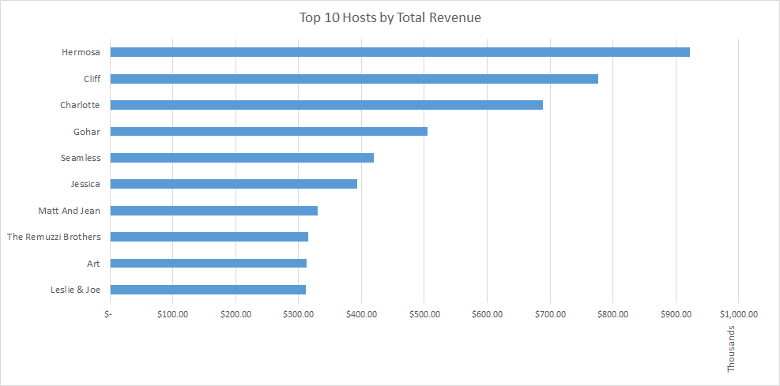
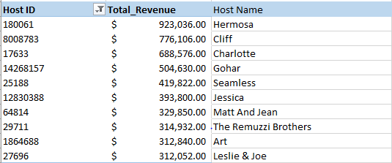
How Much Revenue Do Successful Hosts Generate?
Filtered by Host IDs
Host name column may have different people with the same name
Host IDs are unique values
Used VLookup to find the host name

Slide 5
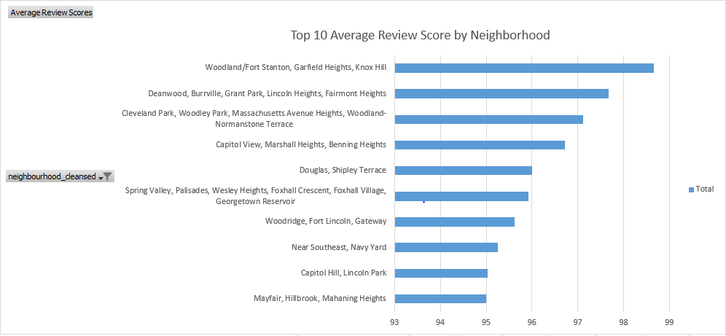

Which Neighborhoods Receive the Most Positive Reviews?
Woodland/Fort Stanton had the highest average review score
The top 10 neighborhoods are all greater than 90 score which is credible
Bottom 10 neighborhoods are the ones investors should avoid to invest on
For further research, recommend looking into the revenue on these neighborhoods

Slide 6
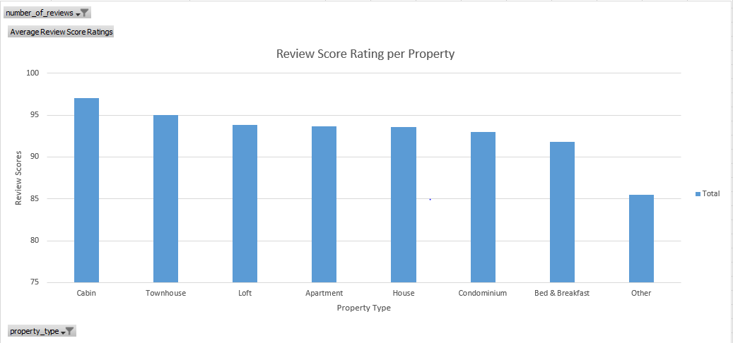
Which Property Types Receive the Most Positive Reviews?
Only included the properties that had the number of reviews per property is greater than the average number of reviews
Most properties had a positive review of scoring more than 90

Slide 7
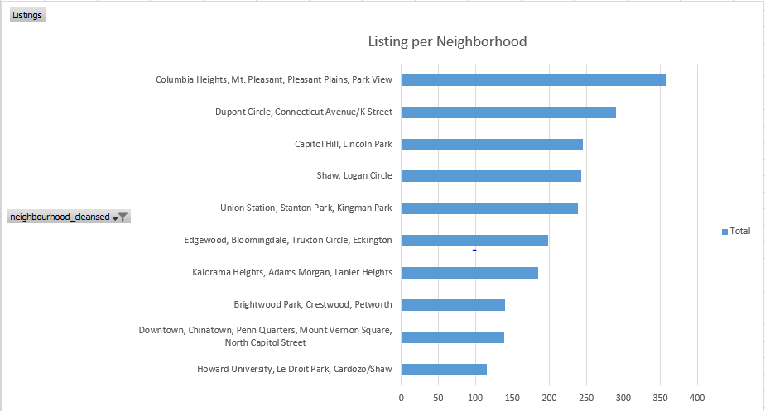
Which Neighborhoods Host the Most Listings?
Columbia Heights had the most listings in its neighborhood
The top 10 are also the most popular neighborhoods that the customers visit

Slide 8
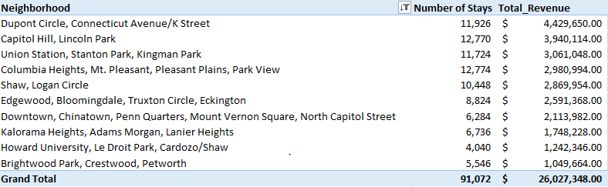
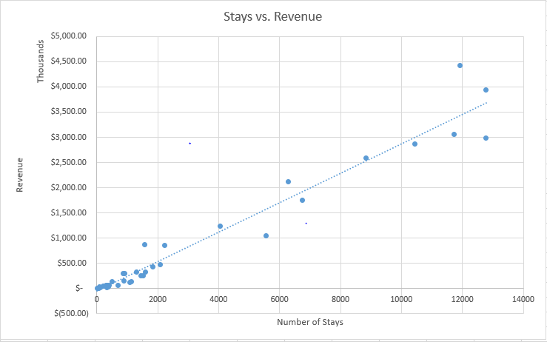
Correlation Between Number of Stays vs. Total Revenue
Both top 10 neighborhoods are exactly the same.
Higher the number of reviews/stays means higher total revenue.
Correlation of 0.9513 within the top 10
Correlation of 0.9771 within all neighborhoods
Strong positive correlation between number of stays and total revenue.

Slide 9
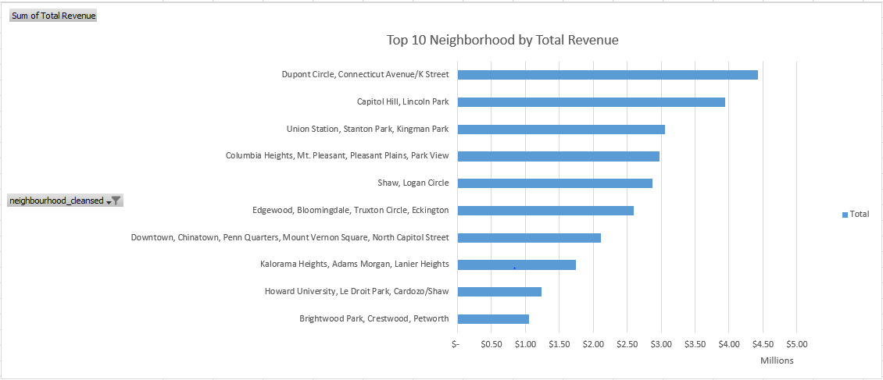
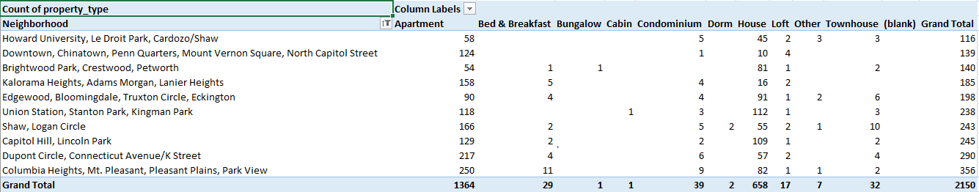
Total Revenue vs. Property Type
Both top 10 neighborhoods by total revenue and by count of property type are the same listings.
The more listings each neighborhood has means there are more availability for the customers to access the properties.

Slide 10
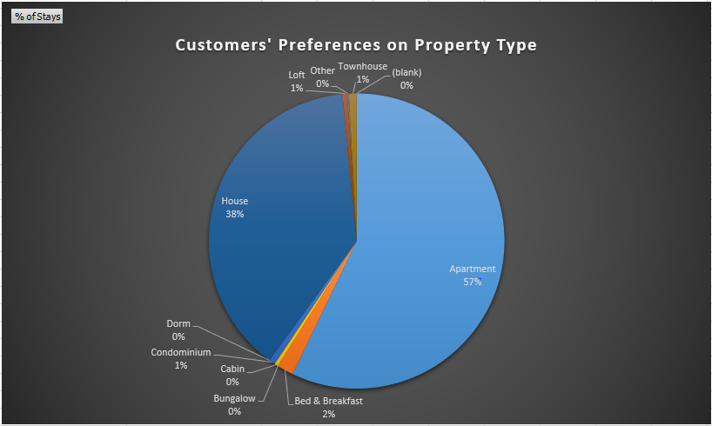

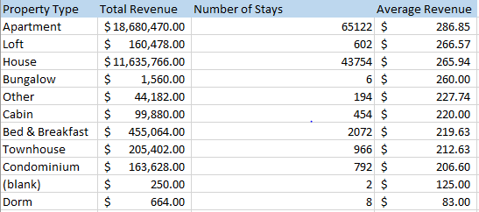
Customers’ Preferences & Average Revenue per Property Type
Shows which property type makes the most money per stays
Top highest average revenues are apartment, loft, and house
Apartment and houses takes up the majority of customers’ choice.

Slide 11

Should our investor invest in an Airbnb hotel in Washington, D.C.?
Yes investors should invest in an Airbnb hotel in Washington, D.C. Before investing, we recommend choosing the location based on the top revenues neighborhoods.
The two neighborhood with the highest revenue:
Dupont Circle, Connecticut Avenue/K Street
Capitol Hill, Lincoln Park
Properties that makes the most revenue:
Apartment
House

